Slide 1

Predicting Hotel Booking Cancellation
By
Agustin Vidal
Zhenyu Wang
Akash Kandarkar
Lokesh Dugar

Slide 2
Agenda
Introduction
Overview
Data insights
Models
Recommendations & Limitation
Conclusion

Slide 3
Hotel Booking Cancellation
Hotel booking cancellation impacts on the operation problem for the hotel.
There is a problem with overbooking for the hotels which lead to loss of sales and fall in customer loyalty.
And customers are accustomed to free cancellation polices, which impacts the loss of sales and fall in business reputation.

Slide 4
Problem Statement
In order to fight the negative effects of cancellation, hotels need to be able to identify which bookings are likely to be canceled.
Does LeadTime and Market Segment related to booking cancelation?
Can we predict with accuracy if a booking will be cancelled based on the attributes?
What incentives we can provide to customers to reduce the booking cancellation?
How many days should the hotel keep between booking date and check in date for free cancellation?

Slide 5
Model Flow of the Project
Thinking about the business questions
Analyzing Data
Running CART to determine which features to choose
Running the SVM model

Slide 6
Dataset
Rows: 40,060
Columns: 20
Source: https://intro-datascience.s3.us-east2.amazonaws.com/Resort01.csv
Data Type: Mostly Categorical

Slide 7
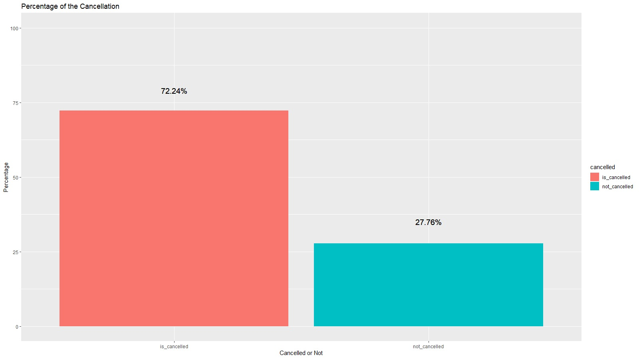
Cancellation vs Non-Cancellation Graph
Based on dataset of 40,000 bookings 11,122 bookings were cancelled i.e. 27.76%

Slide 8
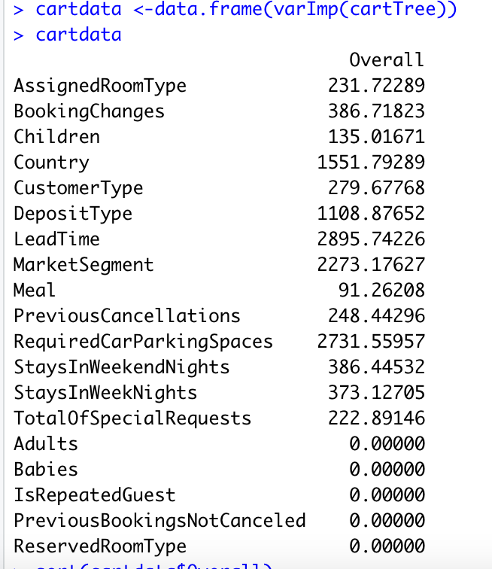
Important Features
Lead Time, Required Parking Space, Market Segment, Country are a few of the most significant variables

Slide 9
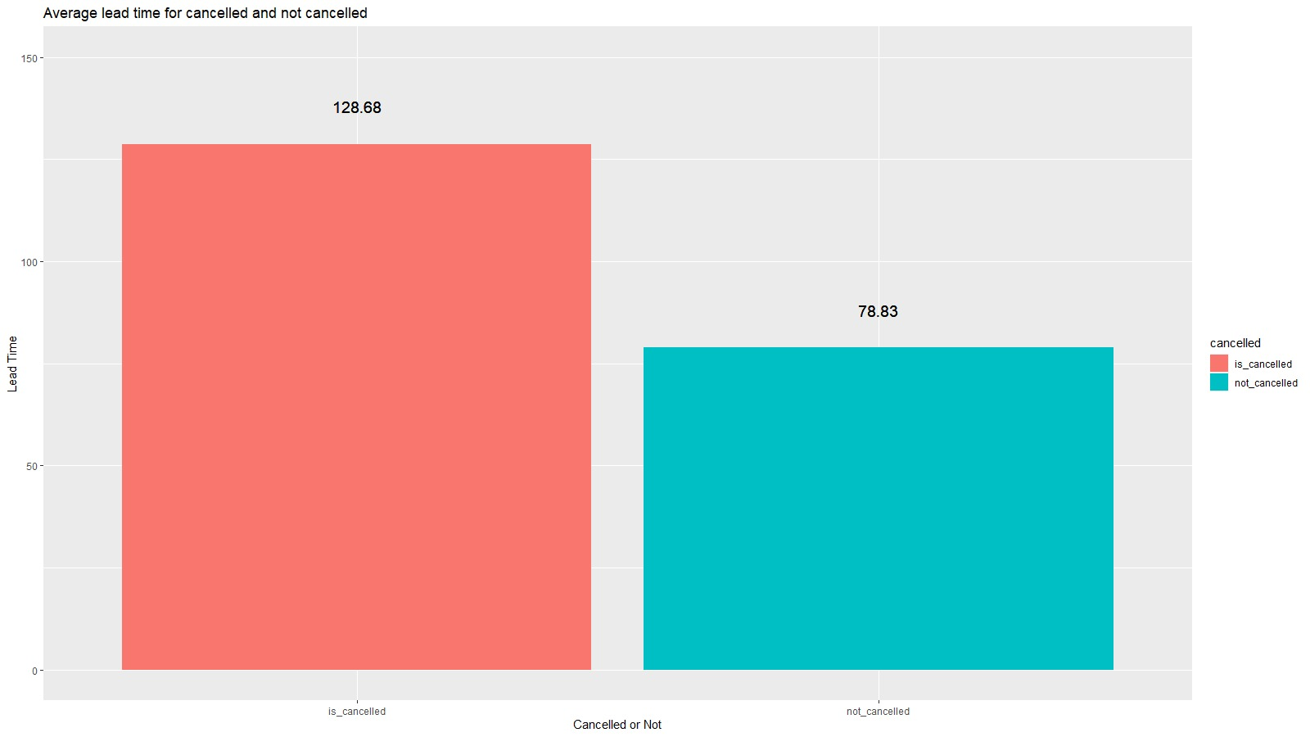
Lead Time Graph
People book their stays almost 2 months in advance.
It was surprising to see that a great number of bookings were made on the same day as the day of check in.

Slide 10
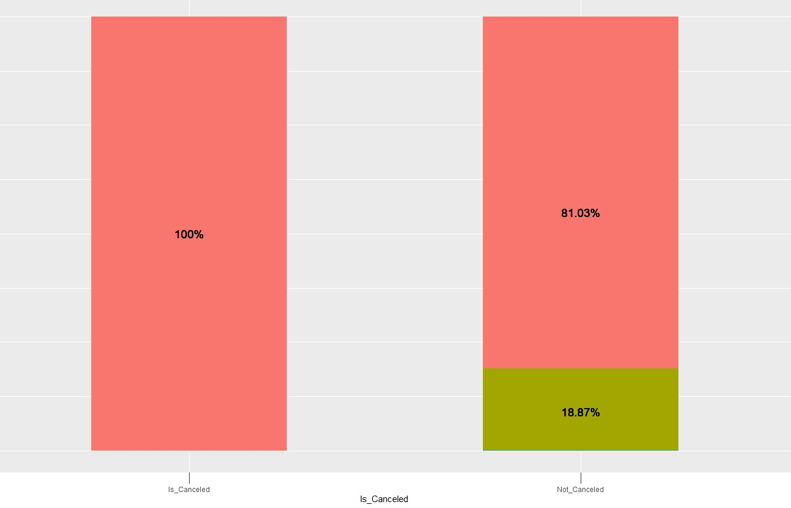
Parking Space
we can see that if the customer is likely to reserve a parking space in a hotel, the chances of that customer cancelling decreases.
There is 18.87% chance that the customer will not cancel his cancellation.

Slide 11
Market Segment
Most bookings in the dataset are done by Travel Agents.
Most cancellation in the dataset are done by group bookings where 73.59% of the bookings are canceled, followed by Online Travel Agents where 54.42% of the bookings are cancelled.

Slide 12
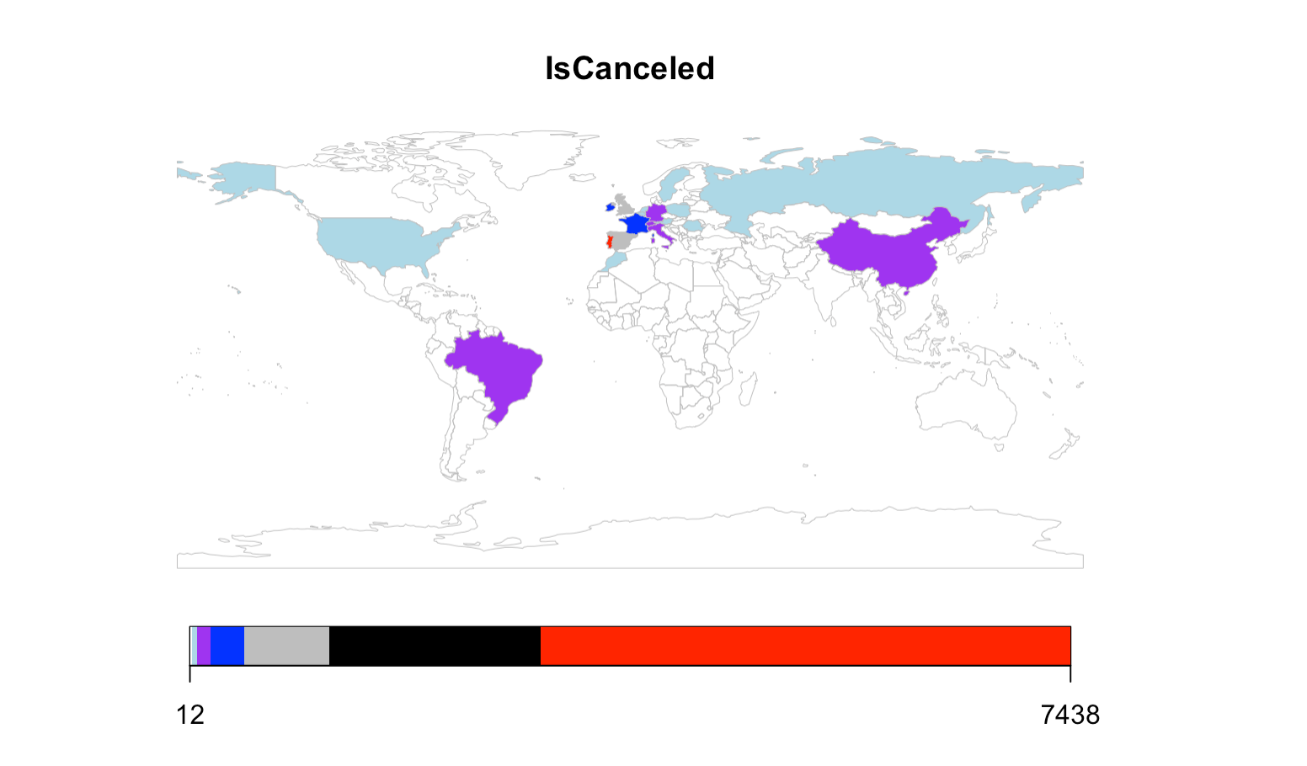
Geographical Cancellation
Portugal has the maximum number of bookings getting cancelled
There is 17,630 cancellation in Portugal which is 42.18% of the total bookings done
Followed by Great Britan with 6,814 than Spain with 3,957

Slide 13
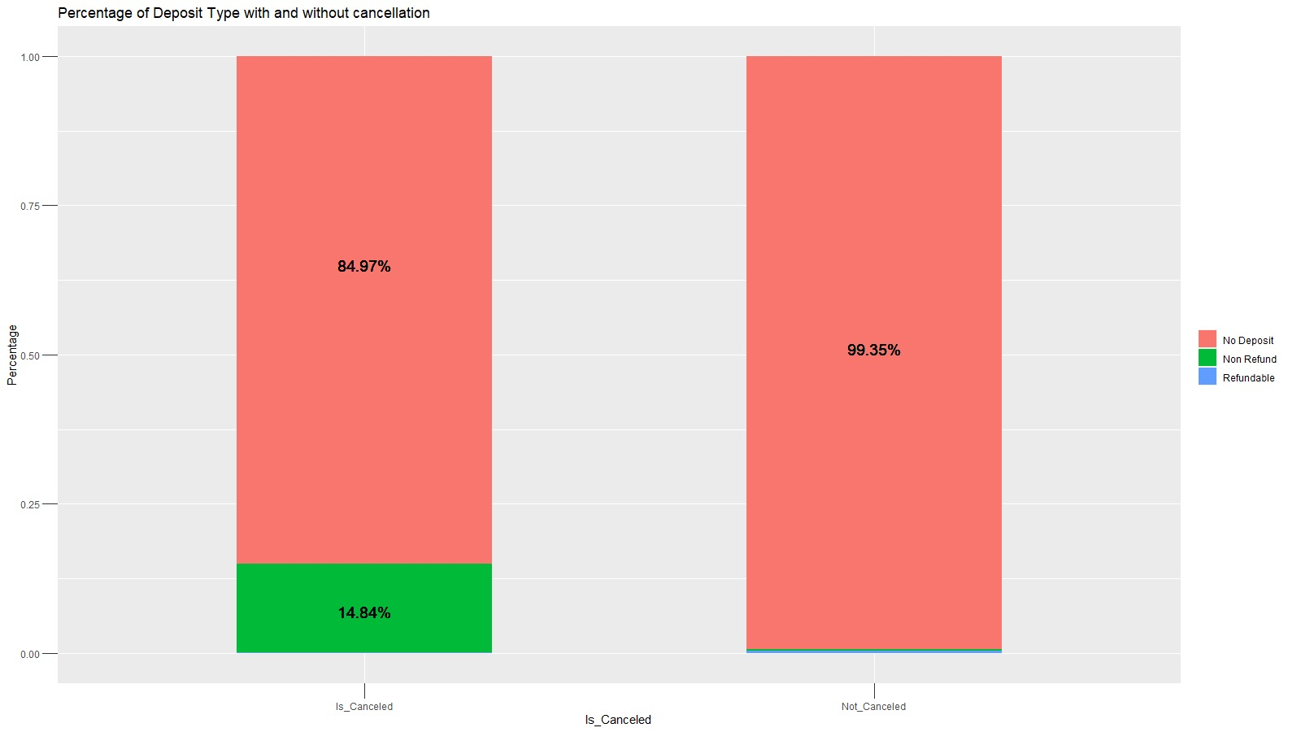
Deposit Type
We can see that when a customer puts in a non-refundable deposit, the chances of cancelation are high.
We also see customers are not bothered by the monetary penalty when deciding to cancel. For hotels, making Non-Refundable rooms will not prevent cancellation.

Slide 14
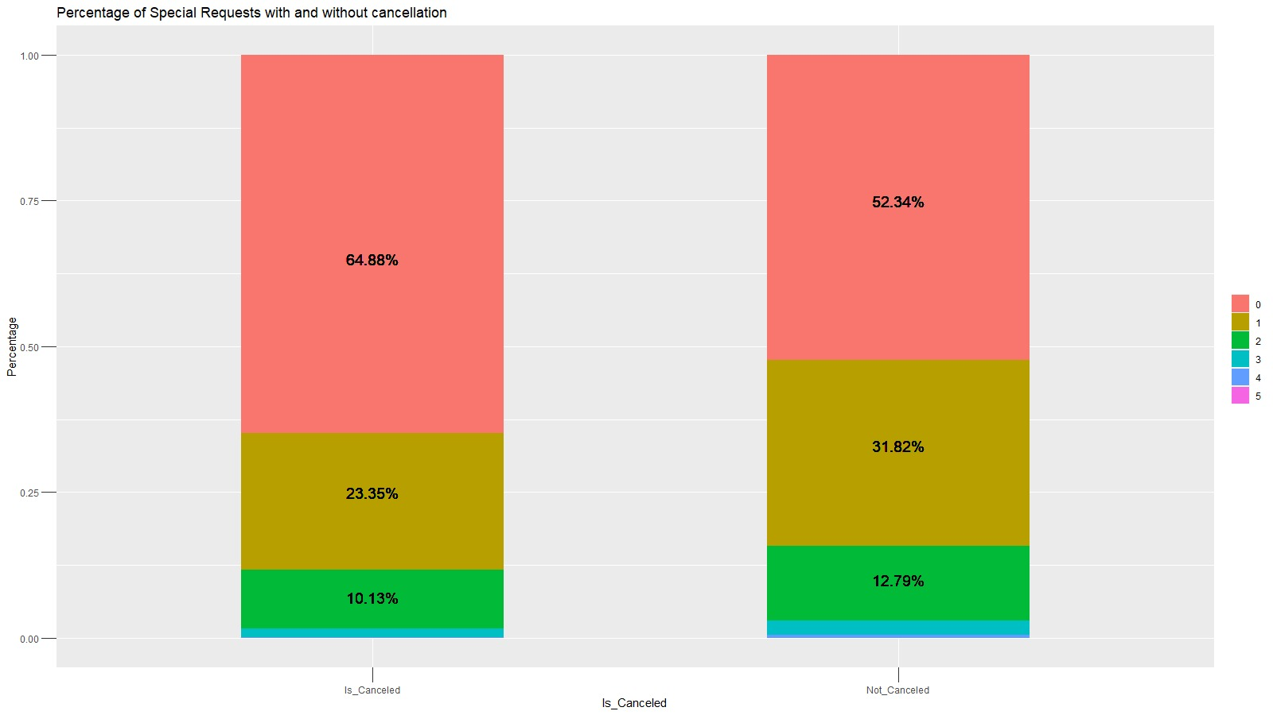
Special Request
From here, we can see that when there are no special requests, the percentage of bookings cancelled is higher than the percentage of bookings not cancelled.
And as the no of special request increases the percentage of cancelation decreases.
With only one special request, there is 31.82% chance of booking not being canceled.

Slide 15

CART
CART TREE GAVE US AN IDEA ABOUT WHICH FEATURES WERE SIGNIFICANT IN PREDICTING WHICH BOOKINGS MIGHT BE CANCELLED.

Slide 16
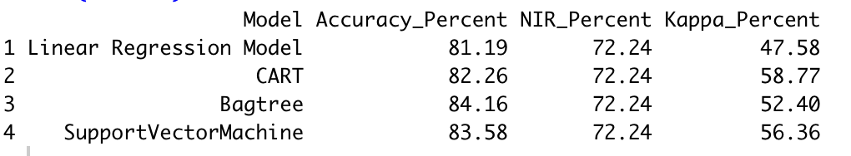
Analysis of all models

Slide 17
Association Rule
THERE'S A 5.434348% CHANCE THAT A CUSTOMER HAS "GROUPS" AS THEIR MARKET SEGMENT, "PRT" AS THEIR COUNTRY, AND CANCELLED THEIR HOTEL BOOKING.
IF A CUSTOMER HAS "GROUPS" AS ITS MARKET SEGMENT AND "PRT" AS THEIR COUNTRY, THERE'S A 75.45927% CHANCE THE CUSTOMER WILL CANCEL THEIR HOTEL BOOKING.
THERE'S A 7.798303% CHANCE THAT A CUSTOMER HAS "ONLINE TA" AS THEIR MARKET SEGMENT, "PRT" AS THEIR COUNTRY, AND CANCELLED THEIR HOTEL BOOKING.
IF A CUSTOMER HAS "ONLINE TA" AS ITS MARKET SEGMENT AND "PRT" AS THEIR COUNTRY, THERE'S A 48.15785% CHANCE THE CUSTOMER WILL CANCEL THEIR HOTEL BOOKING.

Slide 18

Limitations
Lack of customer behavior data
Type of special request

Slide 19
Recommendation & Conclusion
Most of the cancellation are done by online travel agents, need to change the terms and conditions with them
Booking deposit fee should be dependent on how many days ago booking is made
We see that Portugal has the highest number of cancellation.
Determine a threshold number of days for customers to pay convenience fee if booking is cancelled
Customers book 2 months in advance as per observation, if a customer cancels with more than 60 days left within check in, there should be no fee
Special requests and parking space required by the customers when met shows less chances of cancellation

Slide 20

Next Steps
Include more customer behavior
Cross reference results
More classification of data
Finding from different hotels

Slide 21

Thank You

